Slide 1
Operating Systems

Slide 2
Introduction
What is an operating system?
Simple Batch Systems
Multiprogramming Batched Systems
Time-Sharing Systems
Personal-Computer Systems
Parallel Systems
Distributed Systems
Real -Time Systems

Slide 3
What is an Operating System?
A program that acts as an intermediary between a user of a computer and the computer hardware.
Operating system goals:
Execute user programs and make solving user problems easier.
Make the computer system convenient to use.
Use the computer hardware in an efficient manner.

Slide 4
Computer System Components
1. Hardware – provides basic computing resources (CPU, memory, I/O devices).
2. Operating system – controls and coordinates the use of the hardware among the various application programs for the various users.
3. Applications programs – define the ways in which the system resources are used to solve the computing problems of the users (compilers, database systems, video games, business programs).
4. Users (people, machines, other computers).

Slide 5
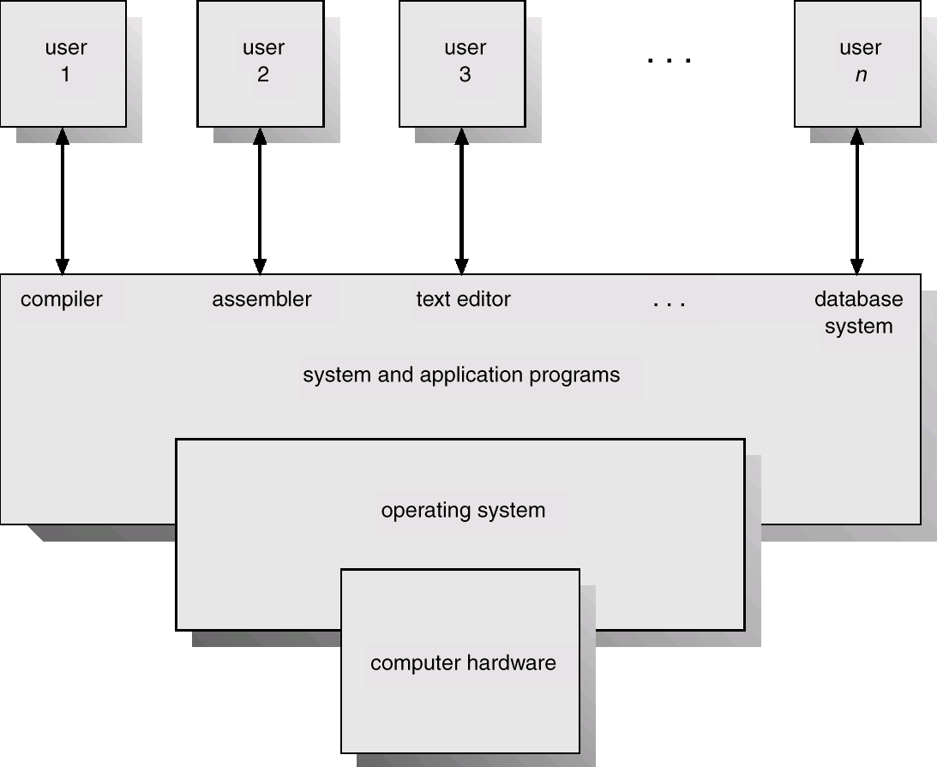
Abstract View of System Components

Slide 6
Operating System Definitions
Resource allocator – manages and allocates resources.
Manages all resources
Decides between conflicting requests for efficient and fair resource use
Control program – controls the execution of user programs and operations of I/O devices .
Controls execution of programs to prevent errors and improper use of the computer

Slide 7
Operating System Definitions
No universally accepted definition.
“Everything a vendor ships when you order an operating system” is good approximation
But varies wildly
“The one program running at all times on the computer” is the kernel. Everything else is either a system program (ships with the operating system) or an application program

Slide 8
Simple Batch Systems
Hire an operator
User ≠ operator
Add a card reader
Reduce setup time by batching similar jobs
Automatic job sequencing – automatically transfers control from one job to another. First rudimentary operating system.
Resident monitor
initial control in monitor
control transfers to job
when job completes control transfers back to monitor

Slide 9
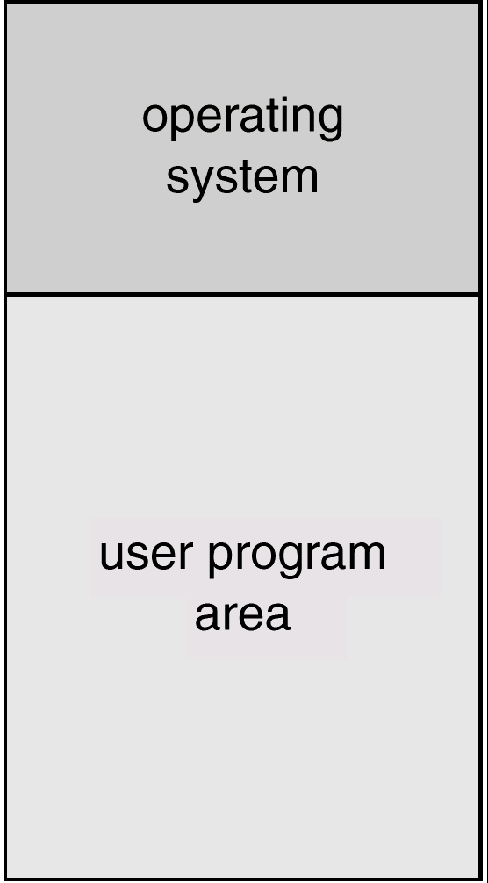
Memory Layout for a Simple Batch System

Slide 10
Control Cards
Problems
1. How does the monitor know about the nature of the job (e.g., Fortran versus Assembly) or which program to execute?
2. How does the monitor distinguish (a) job from job? (b) data from program?
Solution
Introduce control cards

Slide 11
Control Cards (Cont.)
Special cards that tell the resident monitor which programs to run $JOB $FTN $RUN $DATA $END
Special characters distinguish control cards from data or program cards: $ in column 1 // in column 1 and 2 709 in column1

Slide 12
Control Cards (Cont.)
Parts of resident monitor
Control card interpreter – responsible for reading and carrying out instructions on the cards.
Loader – loads systems programs and applications programs into memory.
Device drivers – know special characteristics and properties for each of the system’s I/O devices.
Problem: Slow Performance – I/O and CPU could not overlap ; card reader very slow.
Solution: Off-line operation – speed up computation by loading jobs into memory from tapes and card reading and line printing done off-line.

Slide 13
Spooling
Overlap I/O of one job with computation of another job. While executing one job, the OS.
Reads next job from card reader into a storage area on the disk (job queue).
Outputs printout of previous job from disk to printer.
Job pool – data structure that allows the OS to select which job to run next in order to increase CPU utilization.

Slide 14
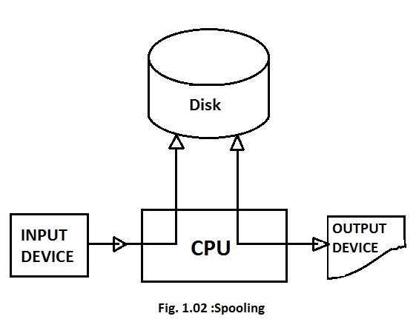
spooling

Slide 15
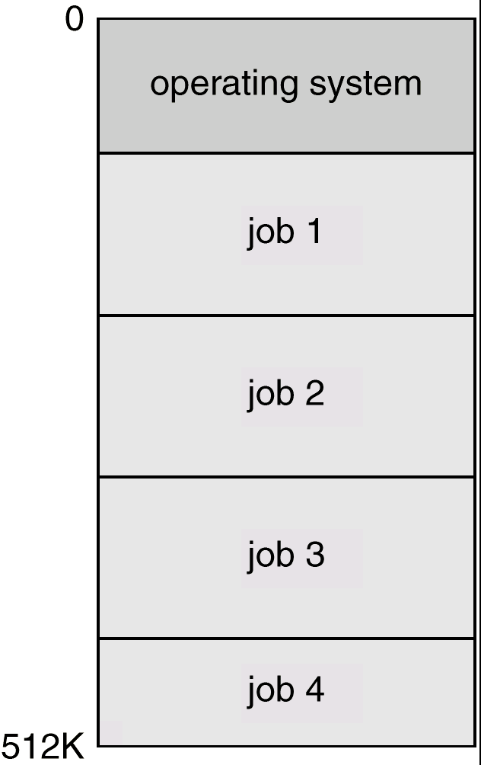
Multiprogrammed Batch Systems
Several jobs are kept in main memory at the same time, and the CPU is multiplexed among them.
MP is a first instance where OS must make decisions for the user
Job scheduling

Slide 16
OS Features Needed for Multiprogramming
I/O routine supplied by the system.
Memory management – the system must allocate the memory to several jobs.
CPU scheduling – the system must choose among several jobs ready to run.
Allocation of devices.

Slide 17
Time-Sharing Systems–Interactive Computing
Difficulties with multi program systems (MPS)
User can not interact with job at the time of execution
Debugged statically from snapshot of dumps
1960 idea of TSS started but not popular until 1970s

Slide 18
Time-Sharing Systems–Interactive Computing
Also called as multi tasking
The CPU is multiplexed among several jobs that are kept in memory and on disk (the CPU is allocated to a job only if the job is in memory).
A job is swapped in and out of memory to the disk.
On-line communication between the user and the system is provided; when the operating system finishes the execution of one command, it seeks the next “control statement” not from a card reader, but rather from the user’s keyboard.
On-line system must be available for users to access data and code.
Multi Programming and Time Sharing are central theme of modern OS

Slide 19
Personal-Computer Systems
Appeared in 1970s
Hardware cost decreased
Smaller (µ computers) and less expensive
Lack of features to protect OS. So neither multiuser or multi tasking
Personal computers – computer system dedicated to a single user.
I/O devices – keyboards, mice, display screens, small printers.
Goals changed to User convenience and responsiveness instead of max CPU utilization and peripheral utilization.
Can adopt technology developed for larger operating system’ often individuals have sole use of computer and do not need advanced CPU utilization of protection features.

Slide 20
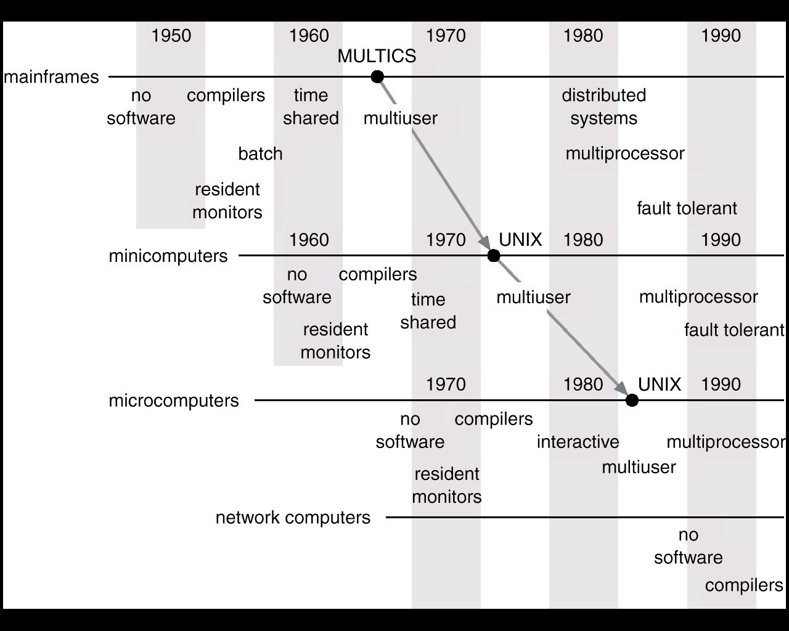
Migration of Operating-System Concepts and Features

Slide 21
Parallel Systems
Multiprocessor systems with more than one CPU in close communication.
Tightly coupled system – processors share memory, bus, peripheral devices and a clock; communication usually takes place through the shared memory.
Advantage is increased throughput, reliability and fault tolerance
Save memory like if several programs operate on same data need not store many times

Slide 22
Parallel Systems
Advantages of parallel system:
Increased throughput
Economical
Increased reliability
graceful degradation
fail-soft systems
Tandon systems
Both hardware and software duplication
Consists two identical processors with local memory connected by bus. One is primary and another is secondary
If failure is detected start from recent checkpoint
At fixed check points state information is copied to backup
This is expensive

Slide 23
Parallel Systems (Cont.)
Symmetric multiprocessing (SMP)
Each processor runs an identical copy of the operating system
Many processes can run at once without performance deterioration.
Most modern operating systems support SMP
Eg: Sun OS ver4
Asymmetric multiprocessing
Each processor is assigned a specific task; master processor schedules and allocates work to slave processors.
More common in extremely large systems
Eg: Solaris 2 ver 5

Slide 24
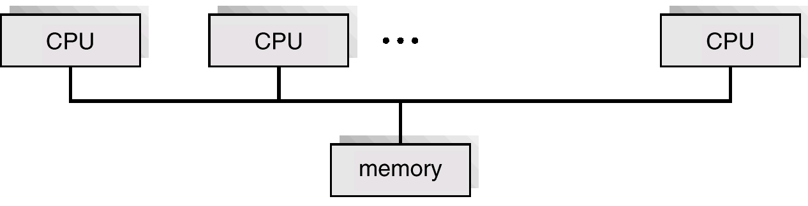
Symmetric Multiprocessing Architecture

Slide 25
Distributed Systems
Distribute the computation among several physical processors.
Loosely coupled system – each processor has its own local memory; processors communicate with one another through various communications lines, such as high-speed buses or telephone lines.
Does not share memory or clock
Processors may vary in size and function
May include small microprocessors, work stations, large general purpose systems etc
Processors referred by a different names like sites, nodes computers etc depends on context

Slide 26
Distributed Systems
Advantages of distributed systems.
Resources Sharing
Sharing files, printers and costly resources like array processors etc
Process info at distributed database and print at remote site
Computation speed up – load sharing
Distributing sub computations
If one site is overloaded may be moved to lightly loaded sites called load sharing
Reliability
if one site fails other can continue operations
More general purpose computers fail does not affect other but if any system is crucial and responsible for I/O etc if it fails, entire system may halt. Sufficient redundancy exists the system can continue even if some fails

Slide 27
Distributed Systems
Communications
Exchange data
Processes can exchange data
Users can do file transfer
Communication with other using mail etc

Slide 28
Real-Time Systems
Another form of special purpose OS is RTS
Often used as a control device in a dedicated application such as controlling scientific experiments, medical imaging systems, industrial control systems, and some display systems.
Well-defined fixed-time constraints.
Hard real-time system.
Secondary storage limited or absent, data stored in short-term memory, or read-only memory (ROM)
Conflicts with time-sharing systems, not supported by general-purpose operating systems.
Soft real-time system
Limited utility in industrial control or robotics
Useful in applications (multimedia, virtual reality) requiring advanced operating-system features.

